Slide 1

COMP40270 cognitive model
DAVID O’ NEILL

Slide 2
BASIC HYPOTHESIS – Single category
This model is partially based on Exemplar theory/ Bayesian inference (updating)
My hypothesis is that when people are categorizing new things, they consider the following:
Out of all known information available (memory), how ‘strong’ of a claim can one make about the category of the new information relative to the information known
They then make a probability claim based on the above.
People also notice unique occurrences and place more emphasis on those

Slide 3
example
“Is ‘X’ a member of category A?”
“Is ‘X’ a member of category B?”
“Out of all known occurrences of Category A, X has occurred 3 out of 4 times’
“Out of all known occurrences of Category B, X has occurred 1 out of 4 times’
X is therefore more ‘dominant’ in Category A
Unique Occurrence
“Out of all the times I’ve seen X, I’ve only ever seen X occur in category A?”

Slide 4
example – Anything is possible
Is ‘X’ a member of Category C? – Maybe??
In this model, we can only consider the information that has been provided. In real life categorizing, I think we are likely to also consider what we ‘don’t know’ in determining our level of confidence in our decision.
‘I’ve only seen ‘X’ once and it was A – My friend works with ‘X’ every day, he would know a lot more. I couldn’t really say what category it belongs to.’

Slide 5
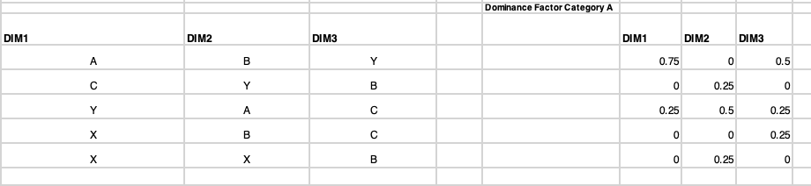
Single categorization – model
STEP 1 - Within category domination
Each category is analysed to check how often the ‘new information’ has occurred previously in the category – This calculation is referred to as the ‘dominance factor’
The dominance factor is the amount of times it occurred divided by the amount of times it could have occurred within that category.

Slide 6
Single categorization - model
STEP 2: Overall Domination
There is a check to see if symptom only occurs in one particular category - If it does, its dominance factor is doubled in order to increase its weight in our decision making
This type of behaviour reduces cognitive cost but isn’t always rational! We may know our experience is limited but still place a lot of significance on it.

Slide 7
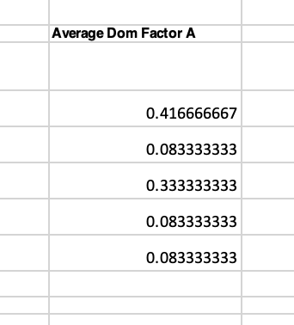
Single categorization - model
STEP 3:
An average dominance factor across all three symptoms is calculated for each category
When there are multiple items occurring together,
items are categorised by taking the average
dominance of each constituent

Slide 8
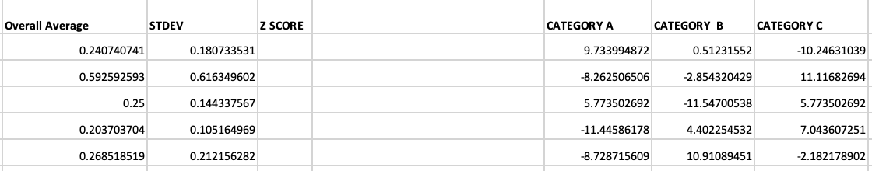
Single categorization - model
STEP 4:
The average dominance values for all categories (all possible categories we know of) are compared and a decision is made based on their relative dominance to each other.
This is done by calculating Z scores for each average dominance factor

Slide 9
Single categorization - model
Answers are then scaled relative to each other. The more positive the Z score, the more likely it belongs to that category and vice versa

Slide 10
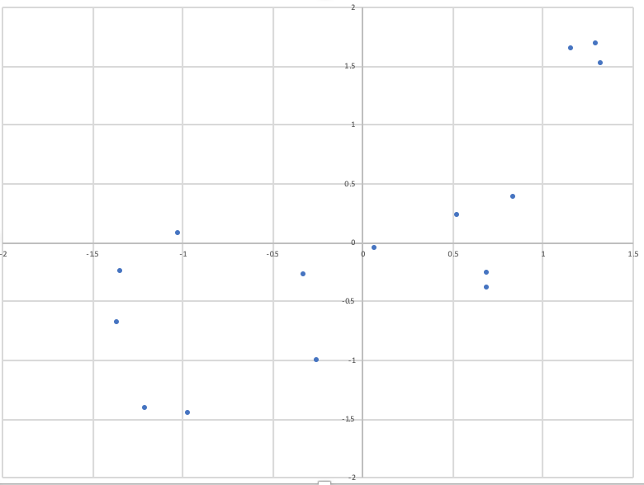
Scatter plot
CORRELATION VALUE
0.766952118

Slide 11
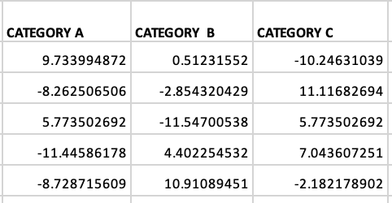
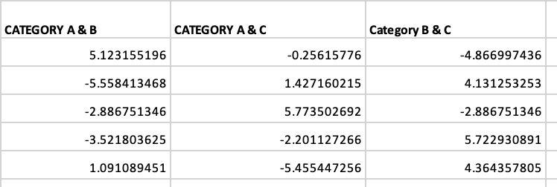
Combined categories - model
ASKS: To what extend are these features ‘defining’ in each category?
The degree to which something belongs to the combined category is the average of the degree
to which it is defining of each individual category.
We have previously calculated the degree to which each test item dominated each category so we can
simply get the average

Slide 12
Combined categories - model
This means….
If something is very like A and very like B then it is very likely to be a member of the category A&B
If something is unlike A and very like B, it is ‘possibly’ a member of A & B
If something is unlike A and unlike B, it is unlikely to be member of A & B

Slide 13
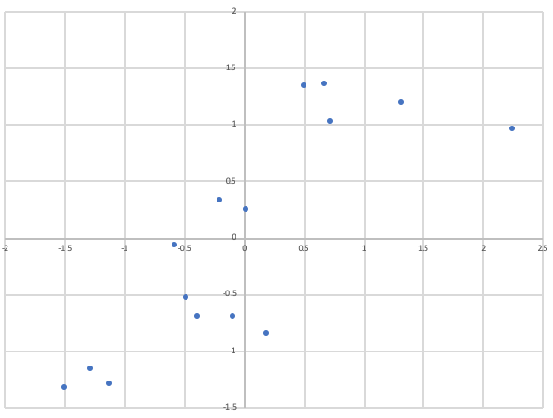
Scatter plot
CORRELATION VALUE
0.818348374

Slide 14
Thank you!

